Slide 1
Classifying Real and Fake Disaster Tweets
Final Capstone
By Malak Mosly

Slide 2
Problem Statement
It is critical to respond to disasters (fires, shootings, etc.) in a timely manner.
Social media sites such as Twitter are a very effective way to report disasters in real-time.
The goal of this project is to create a model that can quickly identify a disaster tweet.

Slide 3
Who can benefit from this model?
News outlets
Disaster relief organizations
Grassroots networks
Politicians
Law enforcement agencies
Fire departments, hospitals, etc.
The general public

Slide 4
Dataset (Kaggle Competitions)
Consisted of 7,613 rows of tweets.
Columns:
ID
Keyword
Location
Text
Target

Slide 5
Project Steps
Data wrangling and cleaning
Exploratory data analysis
Preprocessing and training
Modeling

Slide 6
Data wrangling and cleaning
Dataset was explored (shape, info, value counts)
Text cleaning was the main focus of this step:
Punctuation removal
Emoji removal
Html link removal
Numbers removed
Square brackets removed
All text made lowercase
Stop word removal

Slide 7
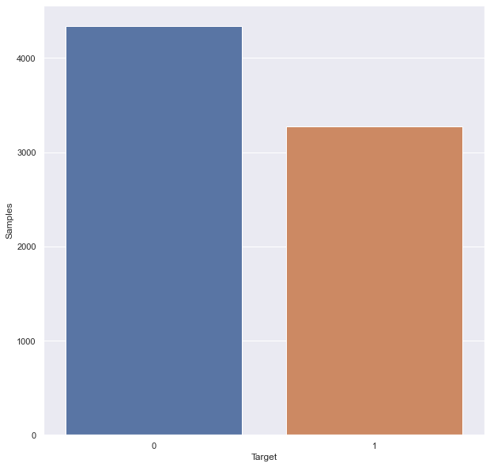
Exploratory data analysis (I)
Distributions of target column

Slide 8
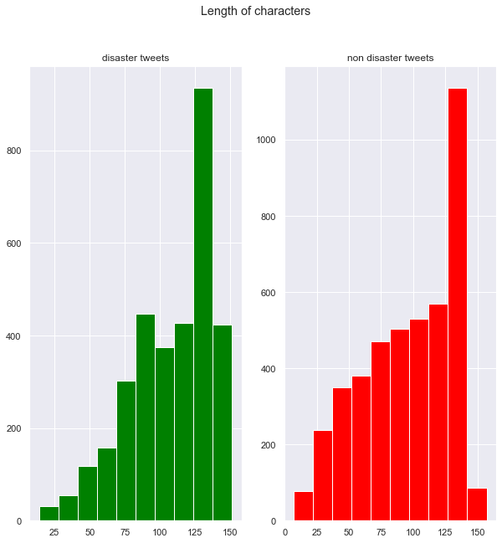
Exploratory data analysis (II)

Slide 9
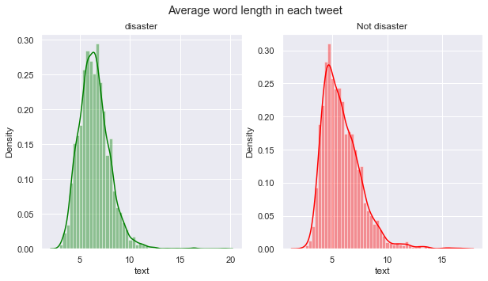
Exploratory data analysis (III)

Slide 10
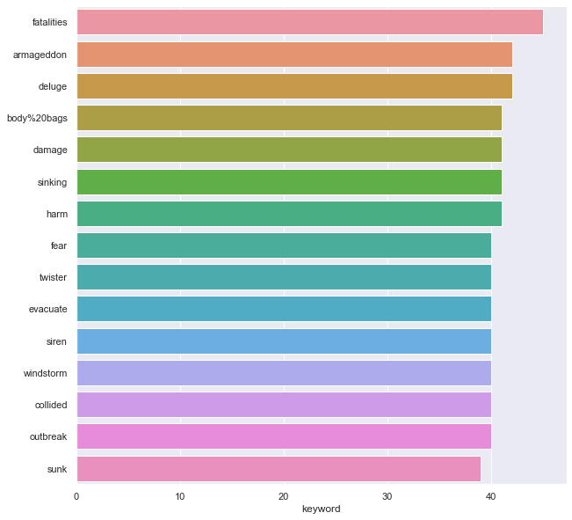
Exploratory data analysis (IV)

Slide 11
Preprocessing and training
Defining X and y:
X → text column (predictor variable)
Y → target column (target variable, binary)
Used CountVectorizer() on text column.
Trian_test_split used to create training and testing datasets.
TF-IDF transformation on text data.

Slide 12
Modeling (I)
Three supervised models chosen:
Naive Bayes
Support-vector machines (SVM)
Logistic Regression
Models were cross-validated and hyperparameter tuning done using GridSearchCV.

Slide 13
Modeling (II)
Performance assessment metrics:
Classification report
Confusion matrix
Cross validation scores
Balanced accuracy scores
Best performing model was Naive Bayes, with 80.22% testing accuracy.

Slide 14
Modeling (III)
Summary of performances:
Model | Testing Accuracy
Naive Bayes | 80.22%
Logistic Regression | 79.78%
SVM | 78.95%

Slide 15
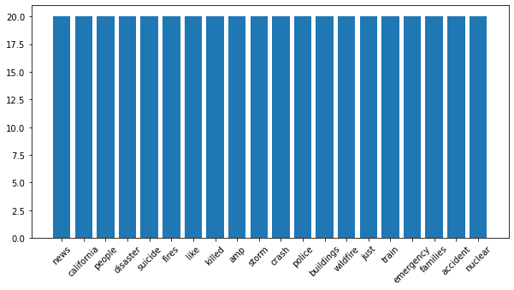
Most important features

Slide 16
Future research recommendations
Expand model to note location and time of disaster
Expand to all types of social media
Model can go beyond fake/real disaster classification

